Slide 1
Online shopping customer review
Customer retention and activation
Juhi Mishra - 11/09/2021

Slide 2
Problem Statement
This Modern era is all about globalisation and modernisation. As we seen online market become one of the most popular market within this 10 year. Not only expanded it’s market and customer also make addicted to most of the population to shop online without going market. This not only saved time, money but also achieved trust which is really important for any of the business to get success. Here the problem statement is all about customer retention and activation as online market is not a monopoly market. High competition and lot many new companies are being trying to capture the market which leads lot many customer volatile and moving from one site to the other very frequently which may be a loss for those who were having good customer base. As any of the business depends upon number of customer they are having, and how much revenue a company are able to generate from their existing as well as new customer. And to retain the customer a company should follow some ethics so that they can be able to hold them and can make good profit to lead the market.
In these a company should try to give good Quality, good service, clarity in information provided on site, system quality,Better discount (including promos and sales offer), Privacy of customer detail, Security of payment,refund and replacement policy and most important trust of any customer which is the base for any business.
So in short online business now a days are facing customer churning which is loss for them and definitely they don’t want to loose their customer, for this will do EDA as taken detailed review from few of the online shoppers regarding pros and cons of online shopping and reason to be volatile. And with the help of this EDA we can be able to know why such attrition is happening and how to curb those.

Slide 3
EDA (Explanatory Data Analysis) Steps
Importing libraries
EDA(Explanatory Data Analysis)
To start the EDA and visualisation imported some important libraries which was will help us to show the graphs required for better understanding. To visualise graph and other plot imported seaborn and matplotlib, As these are the visualisation matrix available in python. To check all the columns used pd.set_option(“display.max_columns”,None).
Checked the shape of dataset to know how many columns and rows do our dataset have. And this dataset is having total 269 rows and 71 columns.
To check what are the data types do we have in this dataset with the help of .info method :
And what we come across that only pin code is in integer form rest all are in object form.
For missing values if any in dataset, used isna() method as isna() method shows even categorical columns missing values too. And this dataset are almost having all the columns in categorical DTypes except pincode.
Found no missing values so no need to treat anything here using mean, median or mode method.
Renamed all the column to make it more short and summarised

Slide 4
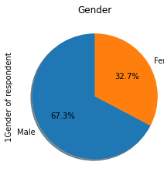
Visualisation required to understand what our dataset is all about
% of Male and Female using online shopping
Let’s have a insight of gender column .
With the help of pie chart we come across that approx 67% of Male are doing online shopping . So here % of female are almost half compare to male this may be because of most of the women may not use smartphone or don’t know how to operate online shopping. So here we can say either lack of information or knowledge may be the reason of this discrimination.

Slide 5

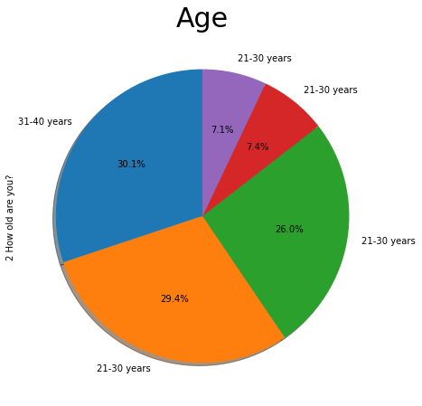
Age group using online shopping
% of Age group using online Shopping
Using online highly matters to age group too, With the help of this insight we will be able to find out what sort of customer do these market capture and how it will help them to know customer base they can make .
So what we came across here is age group from 21 - 40 years are the customers who are mostly doing online shopping, so every online company who wants to retain and have new customer base may use this data by knowing their taste of shopping and what exactly attracts them to have come to this platform.

Slide 6
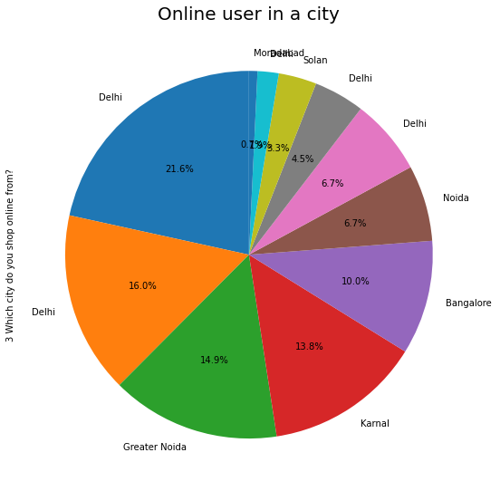
City wise online purchase
With the help of pie chart we come across that mostly the users of online shopping are from Delhi and partial in Noida which is one of the part of NCR. So Main business Hub as city is Delhi . For other city we can say either due to lack of information or resources which may be speed of internet usage of no of smartphones and lot many things are there which can be analysed and try to solve the issues if it is related either to service ,quality concern or some technical issues mainly we face if the site is too big, loading of page may take time. One more factor may be is trust which may affect the business. As most of the customers still scare to use online shopping due to lack of trust. Same thing represented number wise with the help of count method below :
City | No of users
Delhi | 58
Greater Noida | 43
Noida | 40
Bangalore | 37
Karnal | 27
Solan | 18
Ghaziabad | 18
Gurgaon | 12
Merrut | 9
Moradabad | 5
Bulandshahr | 2

Slide 7
Having insight Pincode wise online shopping trend
Here with the help of Pincode too get the same insight as we seen in city from where online shopping being done most. Delhi and Noida are the main hub for online users for shopping.

Slide 8

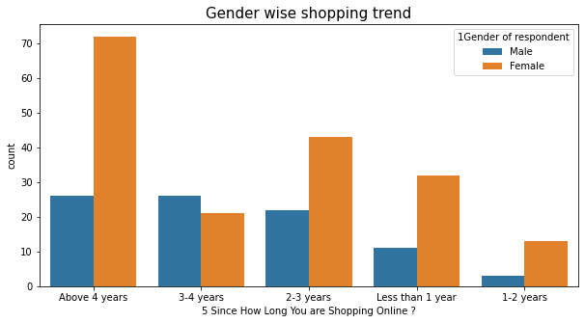
Comparison of gender and no of years they are shopping from
Though the female user were less for online
Shopping as we seen in Gender column insight still no of yeas for female are high in every aspect compare to male.

Slide 9
Summerised Gender wise shopping trend from what period to no of times using online shopping
Used grouping method to check the trend of online users age wise , since how long they are using this service and how many times did they used this?
So what we came across again no of females are higher than male and almost age group for 21 - 50 years females are regular users. This means though the % of users we seen while difference between both male and female using online shopping was less for female but coming to market trend and analysis part in other aspect females are higher in number, compare to male. One more interesting insight that I came across was male above 40 was avoiding to shop online. Which means female users are more compare to male.

Slide 10

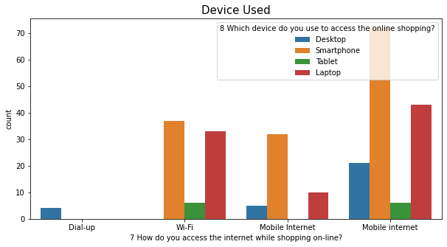
Access vs Device
After getting information that what sort of customers do online retailers have, now trying to get the insight what these customers are using as a device and how do they access internet while shopping online . With the help of this we will be able to know how many customers do have good internet service and what sort of device they use, which brings us the information regarding the problem they may face if don’t have good internet connection which is one of the most important aspect for online users . Even device plays an important role as sometimes due to less space or less device capacity , it takes lots of time for page to get loaded which may affect customer decision and it may turn to abandon the product without making payment.
After looking to the count plot left handside we can say that Smartphone users are more in number compare to other device users. Also As smartphone is more in demand so Mobile internet has beed used widely. So definitely access is not an issue for customers as we can see that most of the users are using smartphone and they can access anywhere anytime without facing much hurdle.

Slide 11

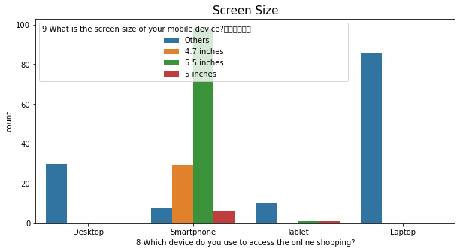
Screen size vs Device used
Screen size of mobile is also one of important insight to see as mainly images of any product attract customers towards them and how large the screen size product image will be that much clear and be attractive.
Here what we came across maximum users are using smartphones with screen size 5.5 inches which is good enough to have the image description clear. Even we can see that Others column users are also in high number which is not mentioned here what is the screen size and what we can see is mainly the users are using laptop for this others. That may be due to few customers may be using laptop for these services for which screen size is mentioned here.

Slide 12

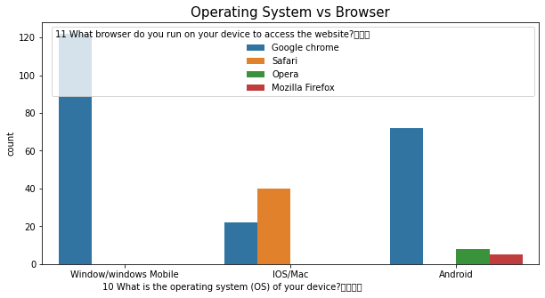
Glance on operation system vs browser
With this insight I wanted to know what type of operating system do our customers uses mainly by taking review from few of the online shoppers and along with which browser . So what we came across is most of the users are using Window version as Google chrome is the highest search engine which being used by most of the shoppers . Even android users too are showing hike in Google chrome only . Here we can see safari is the second highest browser being used which is related to iPhone users . So, we can say that max browser used by online shoppers are Google Chrome or Safari

Slide 13
Browser being used most
With the help of graph in previous slide we came across that Google Chrome is being the most popular browser compare to others. Let’s see the same using count which will give us the no of users for each browser. Even by seeing the table too we got the same insight and it’s a huge number of Google Chorme users compare to any other browser. For safari we can say that only the iOS users can use that search engine as it is an inbuilt feature of iOS only so this may be one of the reason showing less users for safari , as most of the Indian population uses android smartphone and android inbuilt browser is Google Chrome. Mozila Firefox may create issues and not so popular among users now a days same for opera too.
Browser | No of users
Google Chrome | 216
Safari | 40
Opera | 8
Mozilla Firefox | 5

Slide 14
Device being used mostly
Device | No of users
Smartphone | 141
Laptop | 86
Desktop | 30
Tablet | 12
Let’s see no of users for which device are highest and lowest . Here with the help of count we can see that smartphone device being more popular among online shoppers compare to other device . After smartphone Laptop being used mostly. So here we can say that Smartphone are easy to carry and can be used anywhere anytime. While not at all possible in desktop and Tablet is not used for calling purpose so by seeing the need of smartphone which do have almost all the features which a Tablet can do. So tablet is least popular among users.

Slide 15

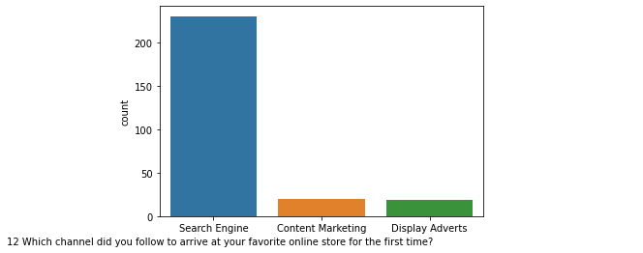
Channel used for searching the site
Channel used for searching Online store
Most channel used by buyers are Search Engine. Rest all are almost negligible. That means most of the focus of all the online company should be on search engine where they can put promos and offers while customer searching for some other product, so that they can get information and can become an activated customer for a company. While investing in content marketing or display adverts are seems to be waste.Same shown with the help of graph (Visualisation Technique) for having more clarity
Channel | No of users
Search Engine | 230
Content Marketing | 20
Display Adverts | 19

Slide 16

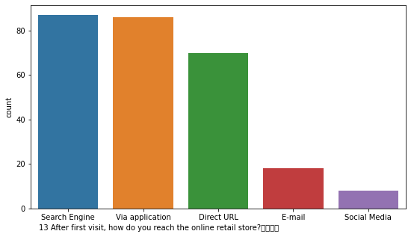
Online store visit via which media are higher
Again the contribution of search engine we can say are higher compare to any other source as maximum number of population are using search engine to reach online retail store followed by via application which also are showing good amount of people are using app to reach the store. Direct URL we can say, may be due to lack of knowledge regarding a particular online store from where to shop as most of the users do habit of just searching product and then going to that particular site for either purchase or to keep it in bag. Even email and social media impact are less for this type of business . Ultimately search engine plays an important role for online business.

Slide 17

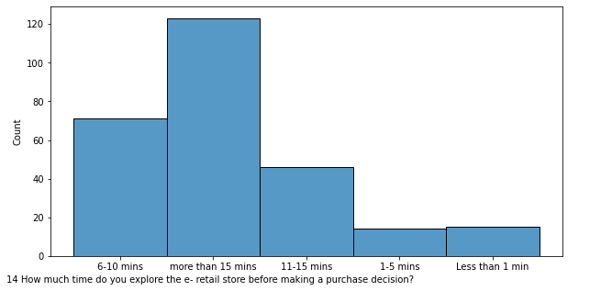
Time takes to explore e-retail store
Decision of choosing e-retail store for any of the customer are really confusing as so many options are available with lot many varieties and offers. So here with the help of histplot got the insight that maximum customer takes more than 15 minutes to choose their e-retail store for shopping, that means a customer is looking from every aspect what is best for them and then make their decision. And it’s obvious that no one can make decision within 1 or 5 min until they already have selected product prior and kept in Wishlist for future purchase.

Slide 18

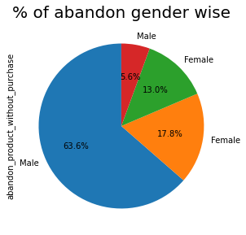
Survey of abandoning product
Abandoning product without purchase become serious problem for most of the online business as frequent mind change of customer may lead to loose customer base. And as a result a company may loose good customer who might be purchasing more from a particular site for a longer period. So it is mandatory to know the reason why abandon happened and whether it can be resolved by any alternative way. Here I tried to get the insight which gender abandoning mostly so that will be able to understand the mindset. From this pie chart we came across that most of the abandon has been done by male that means need to know the reason and how to curb this that an online companies have to focus by having more and more survey and taking their suggestion what improvement they want to see.

Slide 19
Reason to abandon product
Reason to abandon | No of times abandoned
Better alternative offer | 133
Change in price | 37
Lack of trust | 31
No preferred mode of payment | 14
Promo code not applicable | 54
First we got the insight for % of product being abandoned by customers without purchase now will go for the reason why exactly these products has not been purchased by customer. Below the table shows the reason for abandon mostly given by customer while survey , and we came across, mainly the reason was getting best alternative option and promo code not applicable. So here we can say that Customers are comparing almost all the sites and from where they get best offer, avail that and this becomes the main reason for not having a targeted customer for few of the online retailers. So company should focus more on giving good and attractive offers and promos to shoppers so that they can be able to hold the market and become compition for others. Same plotted through graph for better glimpse in next page.

Slide 20
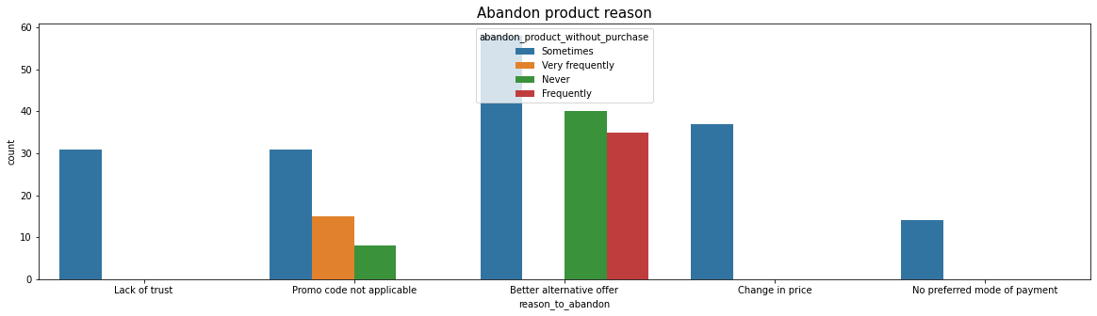
How frequently product being abandoned
Here with help of count plot we can see that not always the product being abandoned. As blue bar is for sometimes. That means when customer gets some better alternative from other retailer they are stepping there for purchase, even we got the reason which affect online purchase is better alternative options and here change in price also is one of the factor for attrition of customer. Here every company should have eye on each other what the other providing better than the, which attracts to goto some other retailer

Slide 21
Content easy to understand
Review | No of people agree
Strongly agree (5) | 164
Agree | 80
Strongly disagree (1) | 18
Indifferent (3) | 7
Now a days using user friendly word for every online products or content is being written most of the places why?
It is because there are mixed customer every business do have. In which some of them able to understand even every technical terms but for most of the Indian customer it’s not easy to catch all the terms so business person who are dealing with direct customer should provide crystal clear information and even content should be written in such that everyone can understand what exactly they mean to say. Here with the help of survey we got information from few of the shoppers how much they agree to this to improve retention and activation of customer.
And what we came across that most of the customers do agree to this that content should be very much clear for them. Only less than even 2% customer disagree to this. Let’s see with the help of table shown right side how many customer do agree to this.

Slide 22

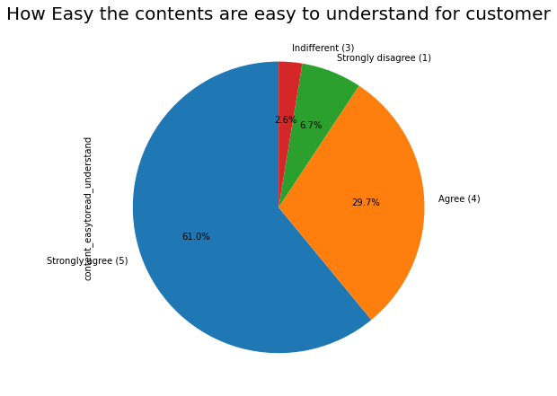
Easy understandable contents for user
The same has been represented through pie graph which being explained in previous ppt through table and here also we got the same insight that almost 61% of the customer strongly agree that contents should be made more understandable and readable in much simpler form.

Slide 23
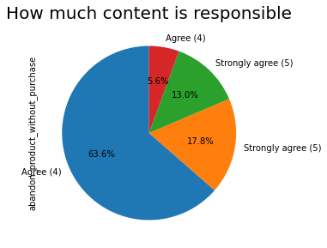
Content responsable for product customer churn
Here with the help of pie chart we are able to get the insight that how much content is the reason behind abandon of product and what we get is almost 63.6% of customer do agree with this that content should be crystal clear for users

Slide 24
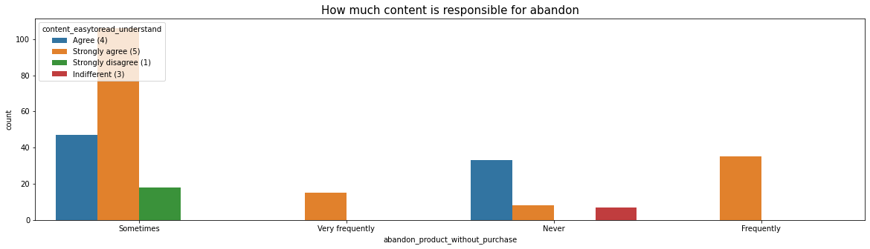
Even with the help of bar plot able to get the insight that though sometimes abandon happen due to this but shoppers agree to have easy content for more readable and easy understanding.

Slide 25
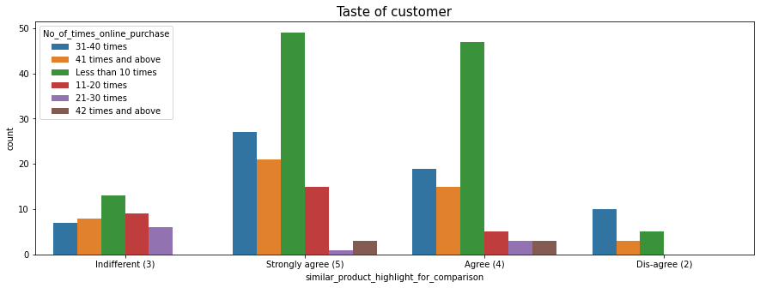
Similar product vs no of time online purchase done
Most of the review after survey shows that though people strongly agree to highlight similar product for comparison still purchase for those product doesn’t shows the hike. That means people choice are volatile here they don’t want to be fix with one thing.

Slide 26

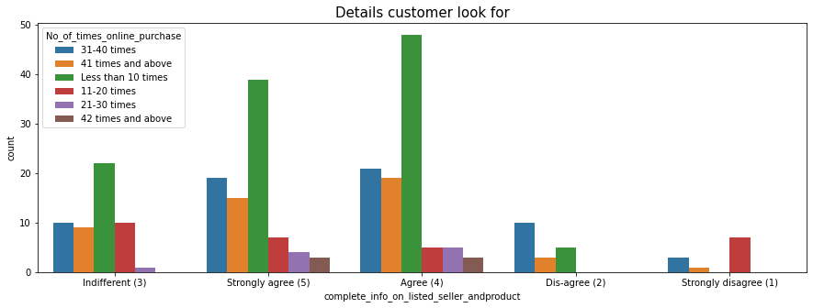
Complete info of listed customer vs purchase
Most of the shoppers agree to this that there should be complete information regarding seller / retailer from whom they are purchasing along with product description in detail. But again this doesn’t help in improving the business of online shopping as we can see that most of the customers are purchasing less than 10 times. This may be either they are not getting the exact information what they want to have or getting confused whom to trust or not.

Slide 27
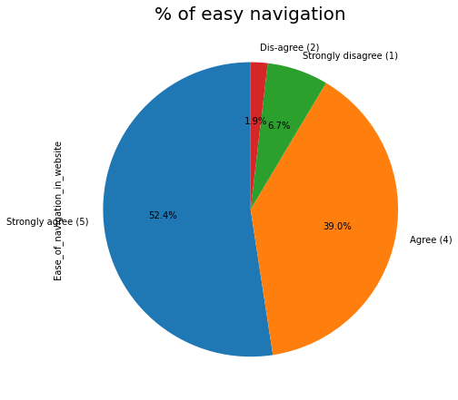
Easy Navigation survey
Here with the help of pie chart we can see that almost 52.4% of the buyers strongly agree and 39% agree to have ease of navigation so that location issue will not become hurdle for online buyers.

Slide 28

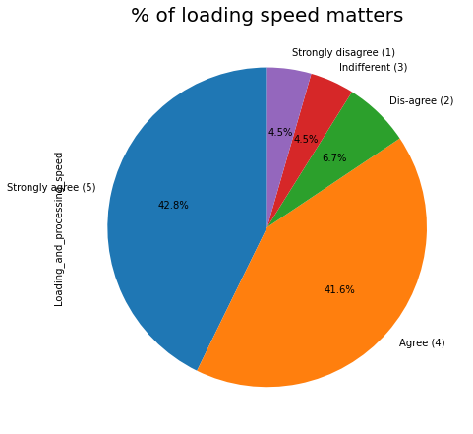
Loading time taken by online sites
As we know that for online shopping speed is also one of the factor which may affect business. If loading of page for any of the site takes time that may irritate customer and they may leave that page without even visiting the site. So in online business world loading speed plays a vital role. 42.8% strongly agree to this and even agree that means rating given 4 to this parameter are also high which shows that an online business should work on this if they don’t have good loading speed or have any issue with page opening , even sometimes during payment this condition may take place which leads customer trust to be on risk.

Slide 29
User friendly website interface
With the help of table we can see that almost rating 4 and 5 has been used mostly for user friendly interface of the website. That means website should be such that anyone can understand how to use and have shopping online. Even convenient payment method has also been given 4 and 5 ratings by user. Ultimately we can analyse that online retailer may have good hold on business if they look after all these factors and be able to solve if any issues faced by online shoppers.
User friendly interface of the website | No of shoppers agree to this
Strongly agree (5) | 189
Agree | 45
Strongly disagree | 18
Dis-agree | 12
Indifferent | 5

Slide 30

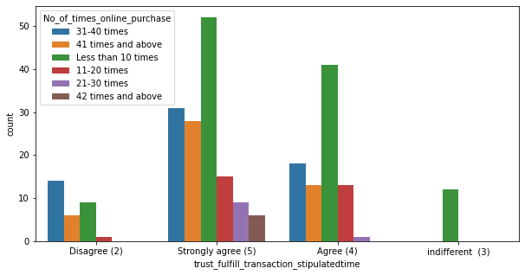
Transaction on stipulated time
Trust is one of the most important factor in any of the business and specially for online business as this business is such where we can’t meet face to face to the retailers or can’t see the product physically. Completely need to rely on what photos are provided by retailer on site and what description they given for the same, also payment method is one of the most important factor where consumer may have trust issues . One of the factor is return and refund policy which should be clearly mentioned and should be processed on time as given. This may lead to gain trust of consumers and can have shopping without any confusion. Same shown using plot for more clarity.

Slide 31
Empathy and query solving
One of the factor that has been given in survey was empathy and query solving which can even change negative customer to positive if the query being solved in time and empathy is the way of showing gesture that you care for your customer which really sometimes proven to be most effective way of retaining customer . And as known that mostly rating given is 4 and 5 for this parameter too.
Empathy and query solving | No of users agree by rating
Strongly agree (5) | 194
Agree (4) | 42
Strongly disagree (1) | 18
indifferent (3) | 15

Slide 32

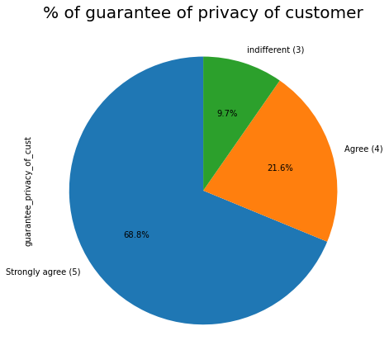
Privacy and security of customer
Keeping privacy each information of customer are really important as these are the personal information which should not be leaked anyhow. If company fails to do so it will not only affect them of loosing customer but will also hamper customer as they give most of the personal information on site while shopping which can be misused by someone and they may be trapped in some problem. And mostly rating also we can see is being gave 5 for this

Slide 33

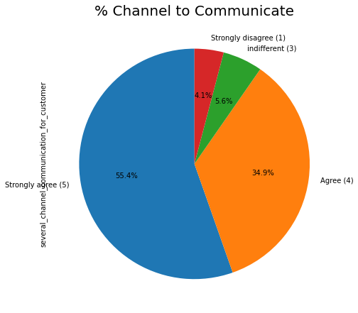
More channel to be introduced to customer for communication
Online retailers should have the facility of multi channel communication as single or bi channel communication may create an issue for customer and may be they won’t reach to the company to resolve their query on time which may again lead to customer attrition, so to curb this online retailer channels should focus to have several channel to communicate.

Slide 34

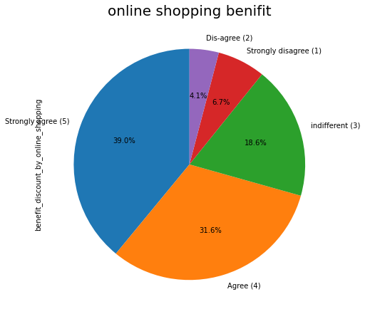
Benefit of online shopping
Most of the time online shopping being proven to be more beneficial than going to shop as promos or offer are being given by most of the site to attract customer so that they can come again again to shop. So here even online shoppers for which survey been done randomly agree to this that are getting more benefit from online shopping

Slide 35
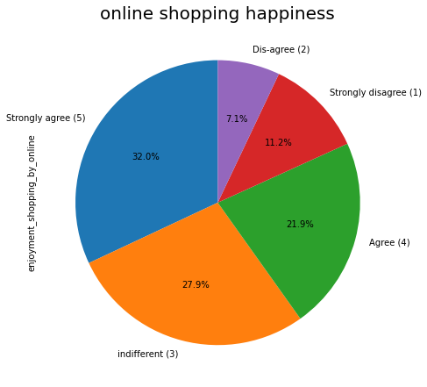
Happiness getting from online shopping
As maximum number of customer do agree that online shopping gives them a sort of happiness. But even there are rating given 3 also nearby to rating 5 which means there are mixed view of every customer.

Slide 36

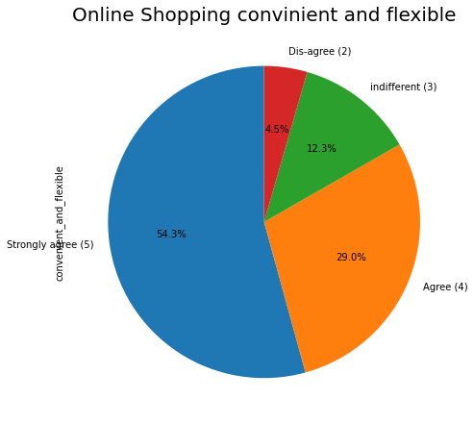
Benefit of online shopping
Most of the customer given 5 rating that means most of them agree that online shopping is convenient and flexible for them as they don’t have to plan prior and have to travel for the same for each and every shopping. As Online shopping can be done anywhere everywhere and no travel time , that means it not only saves time of shoppers but also give them multiple choices from maximum retailers.

Slide 37

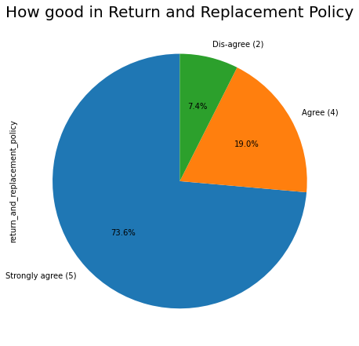
Easy return and replacement policy
An online shopping market should always have easy return and replacement policy so that customer should not face any issue and can have more trust on online shopping. This is also one of the important aspect from business point of view And as we can see that almost 73% do agree to this.

Slide 38

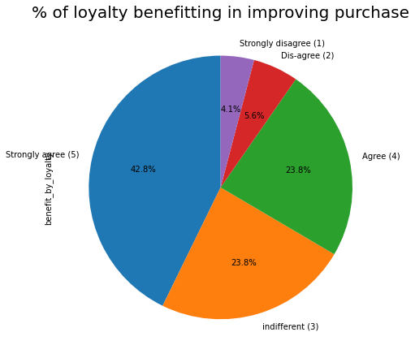
Loyalty Survey
As we are getting the insight from maximum parameters that gaining trust, maintaining security, loyalty are the important key for any of the business to get success. In which online really have to maintain this as I said prior that this is not face to face shopping, customer don’t know any of the retailers by their face or outlet so maintaining loyalty towards customer by online retailers gets doubled. Here even with the help of survey we can see that max rating being used by shoppers are 3,4 and 5, Which means they agree to this strongly.

Slide 39

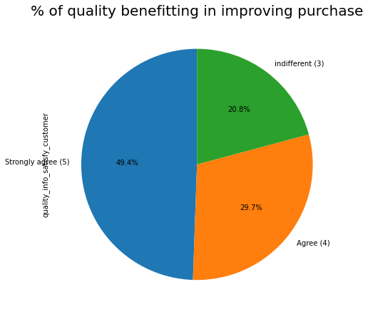
Quality improving purchase
Maintaining quality of product is one of the important factor.If quality will be good and once customer get satisfied definitely for the next time they will try to shop more even will recommend to their friends and family, which may generate new customer for business. And even we can see that almost 70% of the customer agree to this in which 49% had given rating 5 and approx 30% had given rating 4 for this.

Slide 40

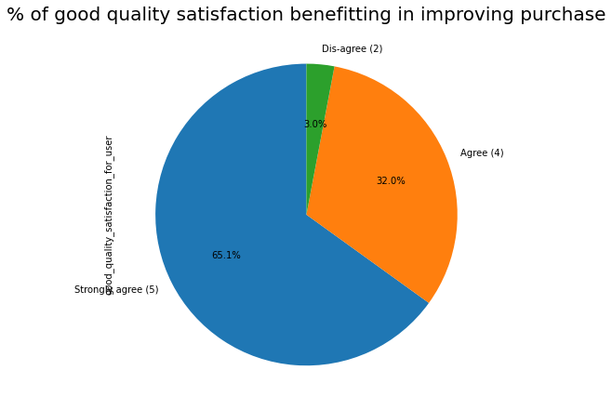
Quality maintaining leads to satisfaction
Here also we can see that almost 97% customer agree to this and given 4 and 5 rating for this parameter. Which means quality really matters a lot for customer.

Slide 41

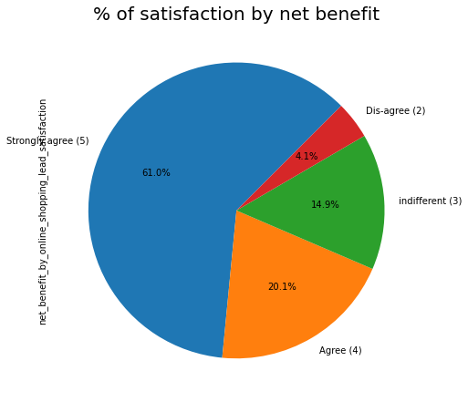
Benefit leads to satisfaction
Here net benefit means overall benefit gained by online shopping. That means Quality, Quantity, service, payment option, return and replacement policy etc. These are the certain parameters which gives net benefit for buyers. And here almost 80% of the customer agree to this as per the survey done and review taken from them.

Slide 42
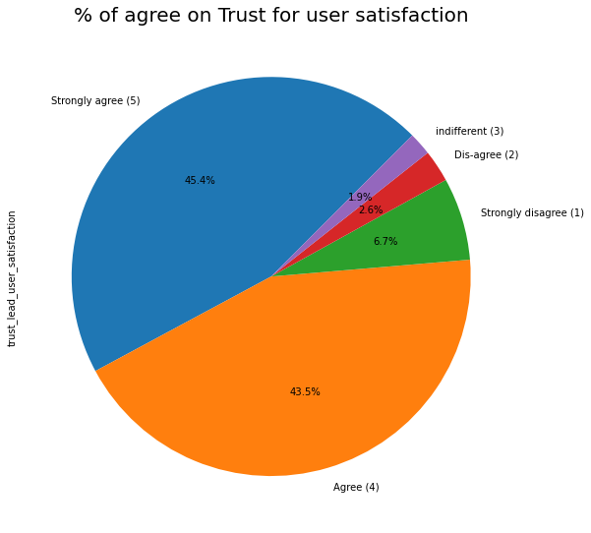
Trust leads satisfaction
Trust leads satisfaction and that’s proven by this survey too as we can see maximum rating being used by customer are 4 and 5 . Means lot many customer believes that trust can give satisfaction as once u feel that the site from where you purchased has satisfied almost all the parameters definitely for the next time will think to purchase from there.

Slide 43

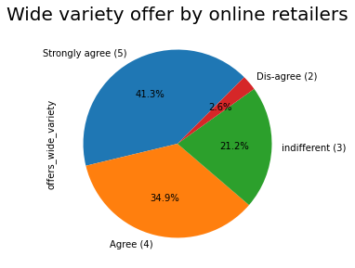
Different variety Offer by online retailer
More the variety more will get the option to choose from. And as in online there are not only one retailer involved , it’s a bunch of retailers listed on site. So the option to choose products become more convenient as lot many varieties offered by different retailers and without going anywhere we can shop what we want even from other city too.

Slide 44

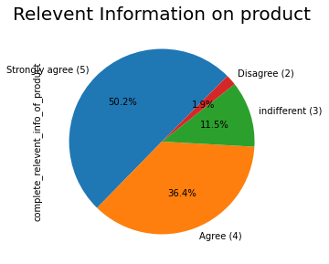
Relevant information of product
Here with the help of pie chart we can see that most of the rating being given as 4 and 5 for information of product should be relevant that means should not be different from what given on site and what getting after delivery. If the information will be crystal clear consumer will have trust on that particular site and there are more chances that they may convert to regular customer and can even refer to their friends and family. And in this way company can not only gain existing customer but can also have new customer in their list.

Slide 45

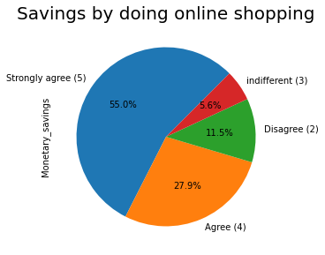
Online shopping not only saves time but also money in every aspect. Very first thing we don’t have to go anywhere so travel cost saved then mostly promos and offers being offered by different retailers which also having good profit for online shoppers as in outlet may be possible that if we purchase in bulk then only get some discount but here quantity doesn’t matter. And as expected we can see that rating being used maximum 4 and 5 for this parameter. That means most of the reviewers agree to this.

Slide 46

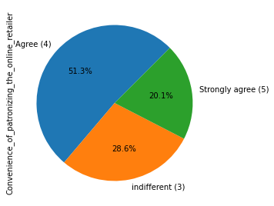
Convenience of prioritising the online retailers
Here buyers are having that convenience to choose their retailers and may add to their bag to whom they want to give more priority, means no restriction to purchase from one or two of the retailers only and they may have variety of options from where they can purchase and here I got the insight that only 3 ratings being used by shoppers i.e., 3, 4 and 5 which means most of the customer agree to this.

Slide 47

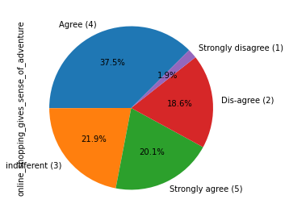
Sense of adventure
Sense of adventure mean to say that mostly we search for those which we don’t get in the market usually and this becomes sometime adventures for consumer. And mostly the rating used for this is 4 that means most of the customer do agree to this that online shopping gives adventures feelings.

Slide 48

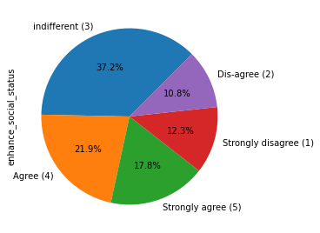
Enhance social status
As we can see with the help of piechart that most of the rating used for this parameter is 3 and 4 which means few agree to this that online shopping enhances social status while most of the customers are there who partially agree and given rating as 3.

Slide 49

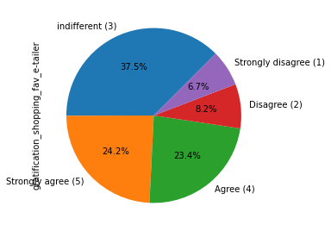
Feeling gratified by shopping to their favourite e-retailer
Shopping online from favourite retailer and getting fully satisfied for what being desired been fulfilled by them really brings a great feelings. And as we can see that rating 5 been given by approx 24% of the customer and 4 by 23% . But here we can see that most used rating is 3 that means neither customer do agree to this nor disagree depends upon situation and service they provide.

Slide 50

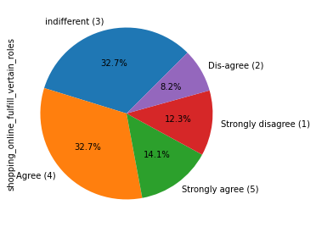
Online shopping fulfils certain roles
For this parameter we can see that maximum rating being given as 3 and 4 that means very less are there who strongly agree to that online shopping fulfils certain roles.

Slide 51

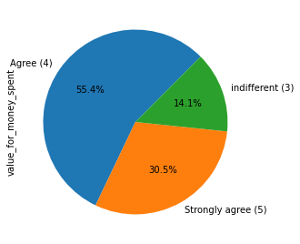
Value for money spent in online shopping
Most of the rating being used as 4 and 5 and very less rating been given as 3 for the parameter value for money spent. So from this insight we came across that most of the customers do agree that spending money online are worth. This we can say because none has given rating 1 and 2 which means strongly disagree. Ultimately shoppers are agreeing to that, online shopping is not a complete loss for them if they improve few of the parameters which being rated 1 and 2 by finding proper reason and if possible can resolve.

Slide 52
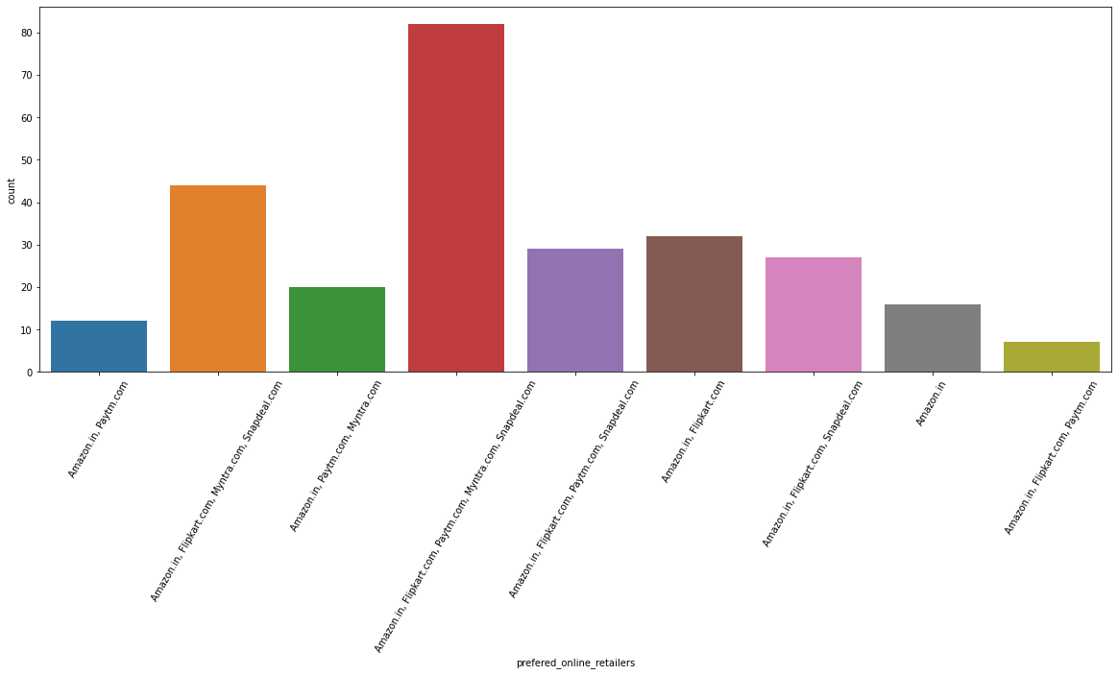
Preferred online retailer

Slide 53
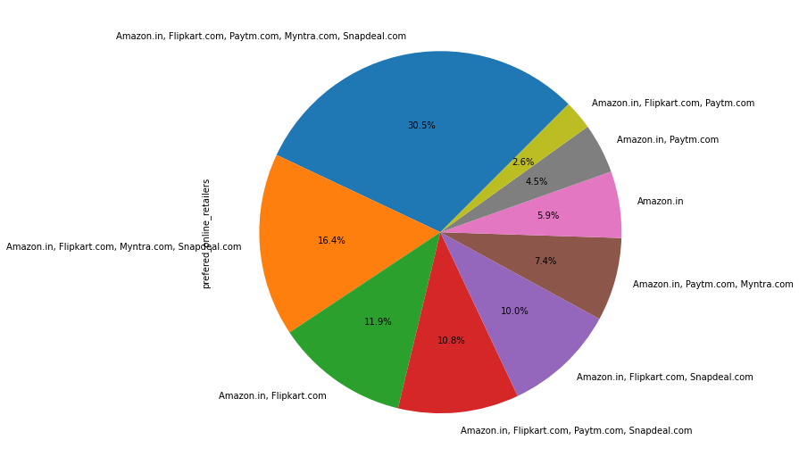
Preferred Online retailers
Prior ppt page do have count plot where we can clearly see that amazon,flipkart,myntra
Paytm and snapdeal are the preferred online retailers for most of the customers.That means none is having monopoly market as customer are volatile here. They use almost all the leading online shopping site to purchase product. From pie graph also we can see that 30.5 % of customer being shopping from different sites depending upon their requirement. Only amazon is such where approx 6% of customer purchase for that particular site. Else we can see the mixed site being used every time. With this I can say that amazon is the one which is a preferred online retailers for at least few of the customer.

Slide 54
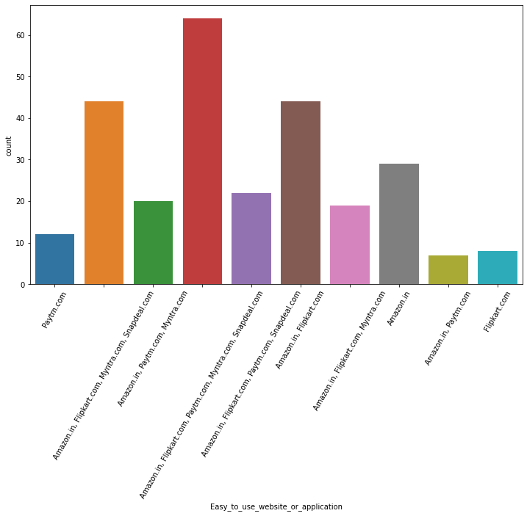
Easy to use website
Here with the help of count plot we can see that most of the users said that almost all the site are same in using application or website. But till the weightage by some of the customer being given to amazon.in which is highest followed by paytm and Flipkart. This means these three websites are easy to handle by few of the customers.

Slide 55

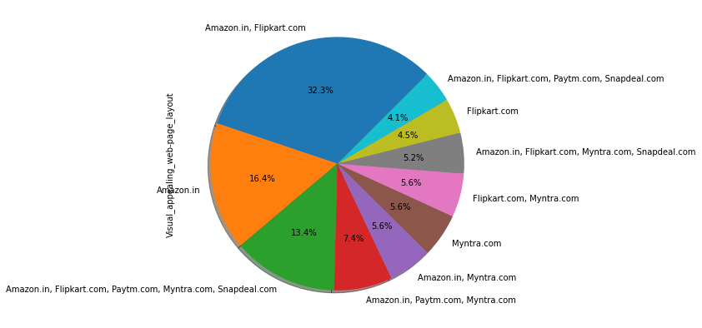
Visualisation appealing webpage layout
Visual appearance now a days must for any business to represent themselves and for online retailers it’s more important as their appearance is their presentation of website only. Website with good design and easy content mostly attracts customer towards them as now a days what being seen attractive will be in more demand. Here in the piechart we can see that individually users rated mostly to amazon as the most catchy visual appearance web page layout as we can see that 32% being given to both Flipkart and amazon in which amazon itself having 16% while Flipkart do have only 4% that means amazon is more famous and presentable compare to other online retailers.

Slide 56
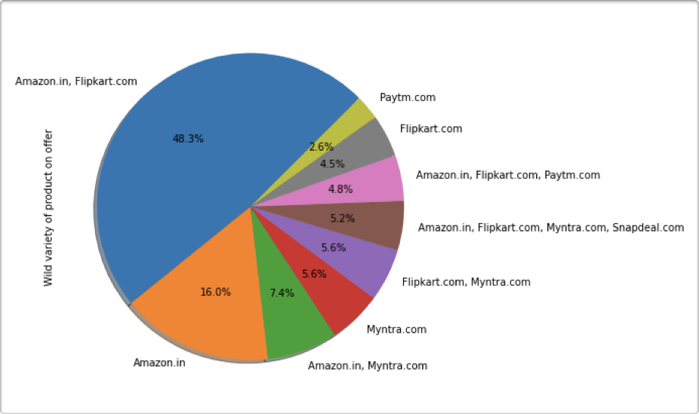
Wide variety of product on offer
Most of online shoppers given higher rating to amazon and Flipkart i.e., approx 48% for having wide variety of product on offer. While again amazon is leading in this with 16% . So every online retailers should have glance that what the offer one site is bringing to customer that 16% of them moving towards that particular site.

Slide 57

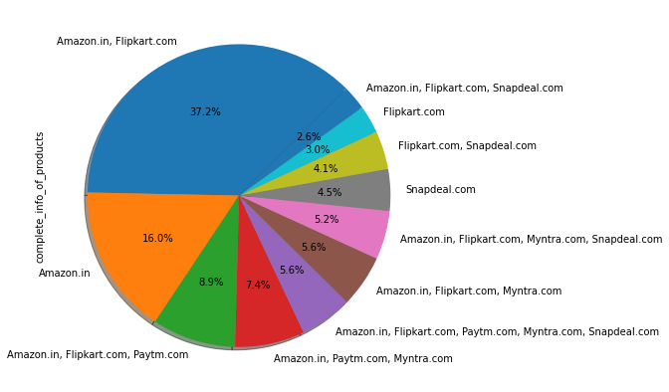
Complete info of products
Again we can see that most of the customers do agree that amazon as an individual website is a leading website with 16% agreed customers who says that amazon do have complete information related to product. Here we can say that in most of the parameters customer choice is amazon even though it’s 16% but compare to others amazon is having higher no of customer independently without mixup with other sites. That means these many customers are having probability most of the time they will buy from this site.

Slide 58

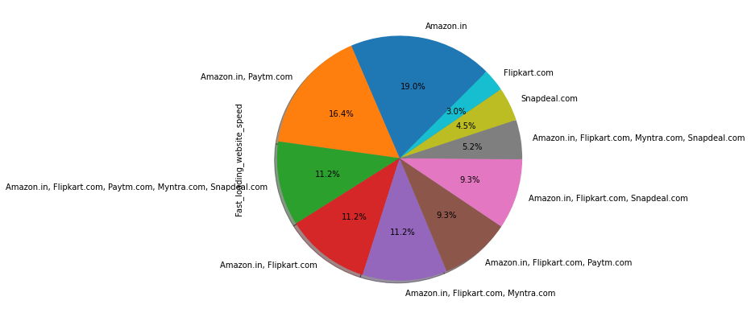
Fast loading website speed
Here I want to get the insight of which site is having fast loading website speed as per users. And in review come across that Amazon is the one who is having highest vote for having fast loading site compare to others . In online business everything depends on internet and loading speed of website as these are the first step towards reaching to site then a customer can purchase so online retailers should have good loading speed of website or page so that customer can buy and can go through the products without any hurdle .

Slide 59

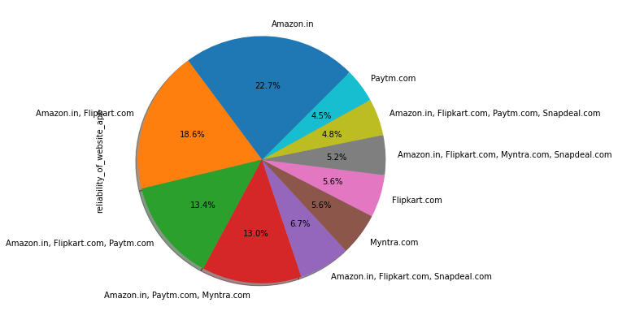
Reliability of website app
A website app should always be trustworthy as these are completely online base and there are most of the site which being not so reliable for use. As we can see that online fraud has been increasing day by day and people do scare to use any of the website in the fear of being cheated or their information may go out. So reliability should be maintained by online retailers else getting once a customer get cheated or fall in trap they will never have use the site and customer attrition will take place. Here in the above pie chart we can see individually amazon is having approx 23% which means good amount of customer who believes that this site is more reliable site for shopping followed by combination of amazon and Flipkart where they are having together 18.6% who believes to shop from these sites. Rest of the site likewise Myntra Flipkart and paytm do have almost same number of customer who believes in these sites individually.

Slide 60

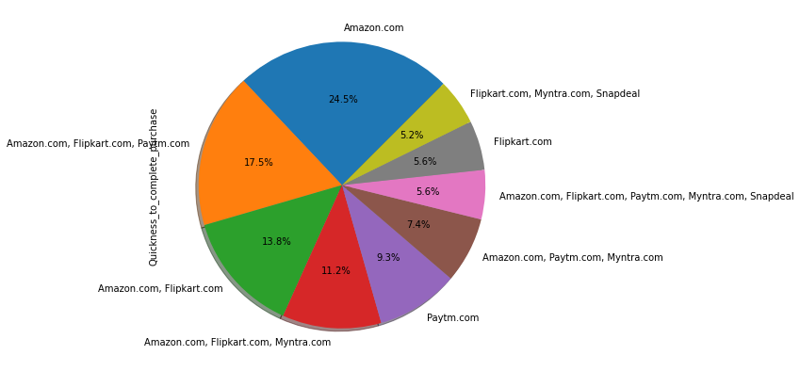
Quickness to complete purchase
How quickly purchase order being completed by company really matters, as most of the customers also sees the time taken by a particular site. If the order being placed on or before mentioned time customer expectation gets fulfilled and they can again come back for other products or shopping.Here again 24.5% of the customer believes that amazon do have good service in this parameter too.

Slide 61

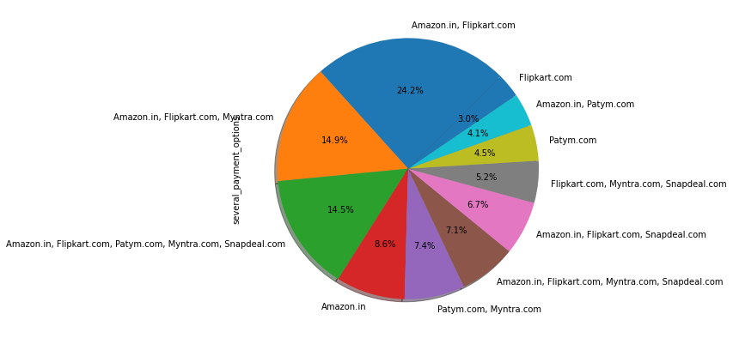
Various payment option
If a customer do have option of several payment option likewise using debit or credit card, upi payment, using paytm wallet, cod etc then that may not restrict to them to purchase from online as getting lot many options to make the payment. Retraction of payment mode may affect customer base for any of the site. Here almost all the online site got same weightage for payment option. That means customer believes that most of the site are giving almost same service for payment option. In this combination of amazon and Flipkart are having higher % which is 24.2%

Slide 62


Speedy order delivery
How fast the order being delivered matters for the customer. Faster the delivery more the customer trust and willingness to purchase will increase. Here again amazon is having good service for delivery as we can see no of customers who agree to this are maximum for amazon site with approx 40%. Followed by combination of amazon and Flipkart which is having 30.5% of users agrees that order delivery are faster compare to other website.

Slide 63

Privacy of customers information
Information of customers should always be secured and privacy for the same should be maintained by the website as these are the private information of customers which may lead them to fall in some trap if leaked out or misused by someone. This is one of the important aspect which every online retailers should focus on. Again amazon individually if we consider is having 26.4% of customers who believe on this site.

Slide 64


Security of customer financial information
Information provided during payment time should be kept private by every website as these are the very crucial information which if leaked may lead a customer loosing their hard money by any of the fraud. Individually we can analyse through pie chart that amazon is having 19% of customers who believes to be safe with this website, rest 5.6% each given to paytm and Myntra that means these three sites individually do have customer base who trust them respectively.

Slide 65


Perceived Trustworthiness
Trustful site we can see here is amazon with the help of piechart, as amazon is having 28.3% of customers who believes shopping from this site are reliable and safe.

Slide 66


Online assistance through multi channel
As we seen in previous survey that most of the customers were agreeing to have multi channel for support or assistance. Here what we came across is Amazon do have that service which attracts customers to trust them more than others as if any customer do face any issues they definitely want help on time so that it get resolved. This not only gains the trust of customer but also gain their priority for their website.

Slide 67


Log in time
21.2% customer agree that amazon do have better log in time. That means this site takes less time to get logged in and in rating also we analysed that most of the customer given to this parameter 4 and 5 that means site should be more faster and less time consuming while trying to reach the page. Snapdeal is in second position with 9.3% of customer who agree that this site takes less time to get logged in.

Slide 68


Time taken by site to display graphics and photos
Here none of the site has been given individual importance for having display of graphics and photos taking time. As we can see from above piechart that amazon and paytm together are having 22.3% of customers who agrees that these sites takes less time to display photos and graphics followed by amazon,flipkart,myntra and snap deal having 14.5%. As we know that there are lot many data and photos due to which these sites takes time to get open. And all the time information or product gets updated due to which sometimes it gets delayed.

Slide 69


Delay in declaration in sales offer
Sales offer which most of the customer wait for if get delayed by any of the site and buyers get better offer from other site, they may turn to that site which may lead to churn of customer and sometimes regular customer do also attracts by the offer given by other sites which they were looking for. So this is important to announce any sales offer on time so that churning of customer can be curbed. With the help of piechart we came across that almost 31-40 times customer turned to some other website by seeing the offers just to grab that. This number of customer attrition are not tolerable for any of the online retailers as 27.9% customers they loosed 31-40 times followed by 41 times with 19.3% of customer just because of delay in announcing their sales offer.

Slide 70


Delay in page loading
Most of the customer agrees that Myntra with 22.7% and paytm with 21.9% very less margin of difference between two are taking time while loading page . While amazon is having very less margin of customer with 5.9% who says that this site takes time to load page.

Slide 71


Limited mode of payment for maximum product
Snapdeal having 32.3% of buyers who agrees that this site do have restriction in mode of payment for maximum product. This may be one of the reason that most of the customer does not prefer this site as much as amazon, Flipkart or Myntra. Even for Amazon we can see that 23% of customers do agree that this site is having limited mode of payment for maximum product. As amazon was having in most of the parameters positive opinion this is only the one in which they are lacking . Should try to improve so that customer should not face any hurdle while shopping.

Slide 72


Longer delivery period
Paytm has been considered as taking long time to deliver the product as 26.8% of customer agree to this followed by snapdeal fo which 23.8% of customer agreed. This may also be one of the reason for attrition of customer.

Slide 73


Website design change affect
With the help of piechart we get the insight that amazon is the one who changes their website mostly as 36% customer agreed to this followed by paytm with 23.4%. This may sometimes be positive and sometimes become negative because people may get confuse of using new changes in website, so changes should be crystal clear which does not bother their customer.

Slide 74


Moving from one page to another may become hurdle
Sometimes due to site issue or server issue moving from one page to another takes lot many time which may irritate customer. And they may abandon the product without making final payment. And even will try to go some other site if having urgency . Here Myntra, Amazon, Snapdeal almost having same majority. Means most of the customer agree that moving from one page to another become difficult for these sites.

Slide 75


Website as efficient as before
From above piechart get an insight that maximum % of customer i.e., 34.9% Agree that amazon website is as efficient as before followed by Flipkart with 17.5% . With the time most of the sites face some issues which become hurdle fo them and leads to attrition of customer, so updating the site really important for every online business.

Slide 76


Recommending online site to friends
Most of the customer recommending amazon to their friends with 29.4% as we analysed previously also that in most of the parameters amazon is really proven to be better site than others. Individually in second number we can see that Flipkart with 14.5 % recommended by customer . That means these two sites may have good customer base as they do get existing customer along with new customer activation by recommendation of existing customer which is really good for these sites.

Slide 77
Assumptions, analysis and conclusion
While starting this project which is related to how to curb attrition of customer and how to activate new or existing customer who left may be of some reason or issues. So to find out the reason behind churning we did random survey of few online shoppers and asked them few of the question which can help online business to get some idea of why this churning is happening and how to curb the same .
Gender wise got the insight that though male is more than female shown in number using online shopping but number of times female are more compare to male who does shopping very frequently. Here assumption was may be most of the female due to non availability of mobile which is the fact that still most of the Indian women do not use smartphone and some don’t know most of the feature how to use them. So this may be one the reason that no of females are showing less compare to male. But we seen that mostly females who do shopping online for more than 4 years are showing more in number compare to male which was just 26 that we seen using count method while no of females who were doing shopping for more than 4 years is 72.
Age wise we got the insight that age group from 21 - 40 years do shopping more compare to other age group. Below 21 most of the teenager do not use mobile or smartphone as they are in study period while above 40 years we can say may be not interested in doing so much of shopping or lack of trust. If it’s a lack of trust or not having much information regarding online shopping, then retailers should have some awareness advertisement using media which everyone follows, can be used more to gain their trust and awareness of how to use the site by easy going steps.

Slide 78
Online shopping maximum are being done in metropolitan city like Delhi, Greater Noida, Gurgaon which all comes under NCR and Bangalore. This may be as we said prior too that lack of awareness and trust may lead to have less customer from semi urban or rural areas. Now a days most of the population uses smartphone so definitely they do have knowledge of online shopping and site but may be how to use that or payment mode or delivery issues or service issues or any of the factor may affect the online business.
As we know that in this modern era more than 70% of the population uses smartphone and they know how to operate the same without any hurdle and even internet usage also become so cheap that this is also not the problem for most of the customer.
Mostly people who are having smartphone or even not they know specially youngsters how to search and goto any of the site. So here google chrome now a days are becoming more user friendly and convenient site giving less issues while visiting any page for android phone and for iPhone inbuilt search engine is safari. So how to visit any online site is not so hectic for customers even they don’t know the exact url of the site as searching through google just by entering name of the site can reach to that particular site. Here I just want to say that even any of the customer don’t know how to reach the site, they can just search it and can visit the page easily with all the information required.
Now after reaching to the site there are not only 10 or 20 retailers which generally we find in any mall or even in market area. Customer will get maximum choice as number of retailers is not the bar in online shopping. Not even city is the constraint. So here buyers will get more option and variety to choose their product even those product which they generally not able to find in the market will able to get here just by entering the name of product in search bar.
Now coming to the loopholes which result in loosing business are, very 1st we seen abandon of product without purchase. This may be because of either that time when buyer added the product in there Wishlist wanted to purchase it later, but may be after sometime changed their mind, either not required anymore that particular product or got the same with better discount from some other site or retailer. If the former one was the reason then still it’s fine as they can search it later when required but later one if the buyer purchased from some other site just because of few factors which present retailer can’t fulfil then it’s a loss of retailer as they are loosing customer here.
If abandon happened then there should be some reason for that and the same has been surveyed , as a result most of them are agreed that they got better alternative option which is really not good as per the business point of view. Online site should always try to resolve issues of their customer by knowing the proper reason of shifting from one site to the other.
By taking the rating from 1 - 5 in which 1 is for strongly disagree while 5 is for strongly agree we found that most of the customer had rated mostly between 4 and 5 for almost all the parameters except few which has been given even 3 but not less than that. Few of the parameters in which easy content, complete information about site, details customer looking for, Ease of navigation, loading and processing speed, user friendly website, convenient payment method, transaction fulfilment trust, empathy and query solving, guarantee for privacy of customer, several channel communication , benefit of discount, enjoying shopping online, Convenient and flexible,Return and replacement policy, loyalty, quality, satisfaction , variety offered, relevant information, monetary savings, priority of retailers , customer rated and shared their valuable information which will not only help online retailers to know the customer choice and need but can also mark themselves how much they are capable to fulfil their demands and if having any loophole can improve the same so that they can retain their existing customer and can attract new customer by offering promos and sales offer or discount time to time along with better service assistance.

Slide 79
Coming to preference of online site we come across that mostly amazon has been given priority in most of the parameters . As we seen that amazon except few parameters they are good in most with having good % of customer in their bag. Either it be preferred online retailer or easy to use website or visual appealing page layout. Here assumption is amazon really doing great job by keeping in mind customers need and priority which makes them leading the market. Other website too should find their loopholes where they are lacking and should work to improve their customer base as we seen that most of the customer are not stick to particular website this may be because of very tight competion in this market, a customer is getting same product in different different site with different discount and price so that is also one of the reason of customer attrition. So retaining customer is really a challenging job for any of the site. They should focus on what going on in the market and why the customer getting move to some other site so frequently .
Conclusion
Overall we can say that each and every information of customer and their privacy should be maintained in a proper manner. Also by giving them quality service and attractive discount may curb the attrition and retain customer to stick to their site. Not only this, gaining trust by solving their issues on time and making them feel that they are one of the valuable customer for them will really be helpful. An online business now a days really become more compititive market as there are lot many sites which offers not only variety but also offers attractive discount along with mostly same service which all other sites are giving. So every online business should have eyes on each other what they are offering and how the customers are shifting to them. This will help them to retain their customer and will be helpful in improving business. Not only this they should also be careful that there should not be any problem in their site as, if that become an issue, mean to say that while purchasing, if site becomes slow or while doing payment site doesn’t work then it may be a problem for customer they may face. There should be clarity of information they are providing online regarding themselves or their product along with graphics or photos, This will not only help them to attract customer towards them but also can activate new and retain existing customer. Online business are not so easy as customer do have trust on information what they provide and product what they try to show them, here we have to understand that this is not a face to face or going outlet and can have shopping by knowing the retailer personally, here customer know them just by their goodwill and rating provided online for their service and quality. So to lead online shopping a retailer should always keep in mind that a happy customer always be an asset for any business and the key for happiness of customer are quality service, on time delivery, good discount, sales and promo offer, less website issues, return and replacement policy, maintaining privacy and many other factors are there which if online retailers can maintain they can retain their customer easily and can have new customer too by reference of existing customer and review given by them online for any product or service.

